Slide 1
Snowflake
Narendra Sarkar

Slide 2
Snowflake Overview
Snowflake Edition
Standard, Enterprise, Business Critical
Snowflake Interface
Snow Site Interface, Classic Console Interface
Worksheet, Dashboard, Data, Compute, Account
Snowflake Architecture
Cloud Services
Brain of the System – Manages Access Control, infrastructure, Security, Optimizer, Metadata Etc
Query Processing - Compute (Virtual Warehouse - XS, S, M, L, XL, 4XL)
Muscle of the system – Perform Massive parallel processing
Storage
Hybrid columnar storage saved in blobs

Slide 3
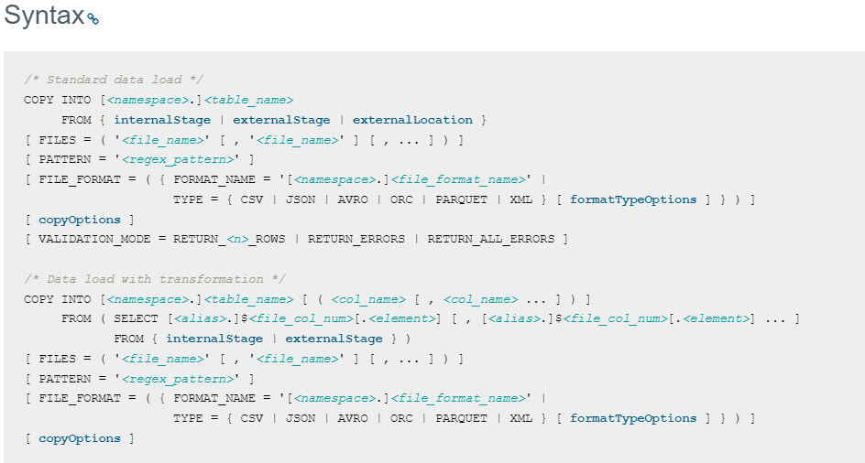
Loading Data in Snowflake
Database, Schema, Table
Copy Command

Slide 4
Loading Data in Snowflake
Bulk Loading
Copy Command
Incremental Load
Snow Pipe
Snowflake Stage
A stage in Snowflake is an intermediate space where you can upload the files so that you can use the COPY command to load or unload tables.
Internal Stage
Stores data files internally within Snowflake. Internal stages can be either permanent or temporary.
External Stage
References data files stored in a location outside of Snowflake such as AWS S3, Azure Container, Google Cloud Storage Buckets

Slide 5
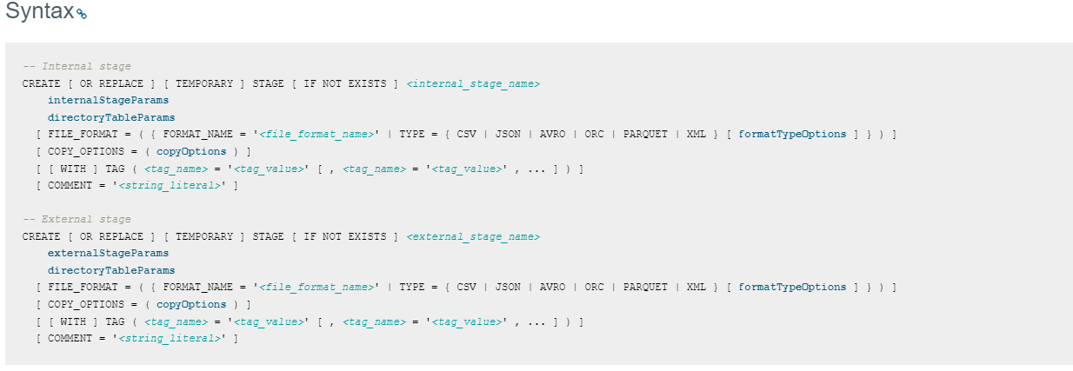
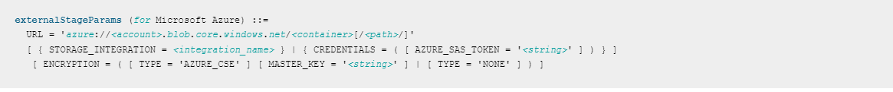
Creating Stage

Slide 6
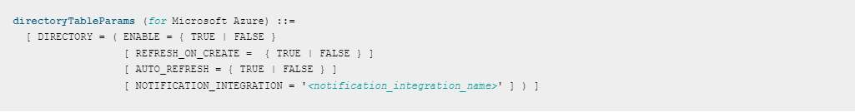
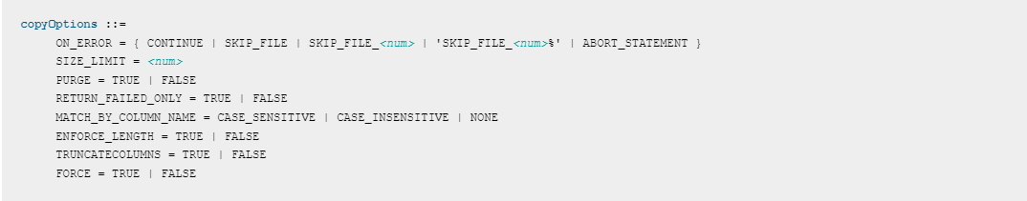
Creating Stage

Slide 7
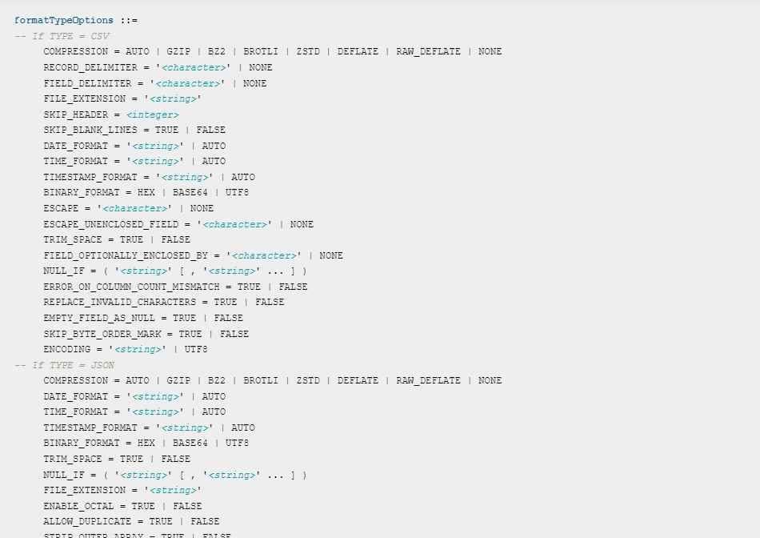
Creating Stage

Slide 8
Loading Structured Vs Unstructured Data
Relational Table
Raw Table format ( raw_file_variant)
Json
Parquet

Slide 9
Performance Optimization
No Partition, No Indexes
Appropriately Sizing the Virtual Warehouse
Create dedicated Virtual Warehouse for Certain User Groups
Auto Scale up the Virtual Warehouse Based On Workload
Dynamic Scaling Out for unknown patterns of Workload
Maximize Caching Usage
Cluster Key for Large Tables

Slide 10
Snowpipe - Intro
Snowpipe enables automatic loading of data as soon as files is available in the stage
The data is loaded according to the COPY statement defined in a referenced pipe.
A pipe is a named, first-class Snowflake object that contains a COPY statement used by Snowpipe. The COPY statement identifies the source location of the data files (i.e., a stage) and a target table.
All data types are supported, including semi-structured data types such as JSON and Avro.
Different mechanisms for detecting the staged files are available:
Automating Snowpipe using cloud messaging
Automated data loads leverage event notifications for cloud storage to inform Snowpipe of the arrival of new data files to load. Snowpipe copies the files into a queue, from which they are loaded into the target table in a continuous, serverless fashion based on parameters defined in a specified pipe object.
Calling Snowpipe REST endpoints
Cient application calls a public REST endpoint with the name of a pipe object and a list of data filenames. If new data files matching the list are discovered in the stage referenced by the pipe object, they are queued for loading. Snowflake-provided compute resources load data from the queue into a Snowflake table based on parameters defined in the pipe.

Slide 11
Setting Up Snow Pipe
Create Stage
Create Copy Command
Create Stage containing Copy Command
Set Event Notification to Trigger Pipe

Slide 12
Snowflake Time Travel
Using Time Travel, you can perform the following actions within a defined period of time
Query data in the past that has since been updated or deleted.
Create clones of entire tables, schemas, and databases at or before specific points in the past.
Restore tables, schemas, and databases that have been dropped.
To support Time Travel, the following SQL extensions have been implemented:
AT | BEFORE clause which can be specified in SELECT statements and CREATE … CLONE commands (immediately after the object name). The clause uses one of the following parameters to pinpoint the exact historical data you wish to access:
TIMESTAMP
OFFSET (time difference in seconds from the present time)
STATEMENT (identifier for statement, e.g. query ID)
UNDROP command for tables, schemas, and databases.

Slide 13
Snowflake Time travel(Cont’d)
Querying Historical Data
select * from my_table at(timestamp => 'Fri, 01 May 2015 16:20:00 -0700'::timestamp_tz);
select * from my_table at(offset => -60*5)
select * from my_table before(statement => '8e5d0ca9-005e-44e6-b858-a8f5b37c5726');
Cloning Historical Objects
create table restored_table clone my_table at(timestamp => 'Sat, 09 May 2015 01:01:00 +0300'::timestamp_tz);
create schema restored_schema clone my_schema at(offset => -3600);
create database restored_db clone my_db before(statement => '8e5d0ca9-005e-44e6-b858-a8f5b37c5726’);
Restoring Objects
undrop table mytable;
undrop schema myschema;
undrop database mydatabase;
Seeing History
show tables history;

Slide 14
Snowflake Table, Schema, Database Type
Permanent (Create table, Create Schema, Create Database)
Time Travel Retention Period – 0-90 Days
Fail Safe
Temporary(Create Temporary Table, Create Temporary Schema, Create Temporary Database)
Time Travel Retention Period – 0-1 Day
No Fail Safe
Life is limited to Session Scope Only
Non Permanent Data
Transient(Create Transient Table, Create Transient Schema, Create Transient Database)
Time Travel Retention Period – 0-1 Day
No Fail Safe
Use when data doesn’t need to be protected

Slide 15
Zero Copy Cloning
Create Copies of Data Storage Object - Database, Schema, and Tables
Create Copies Configuration Object – Stage, File Format, Task
Clone object is independent from the Original Object
Easy to Copy All Metadata and Storage Management
Create Table <Clone-Table-Name> Clone <Source-Table-Name>
Create Table <Clone-Table-Name> Clone <Source-Table-Name> Before (Timestamp=><Timestamp>)

Slide 16
Snowflake Data Sharing
Secure Data Sharing enables sharing selected objects in a database in your account with other Snowflake accounts. The following Snowflake database objects can be shared:
Tables
External tables
Secure views
Secure materialized views
Secure UDFs
Snowflake enables the sharing of databases through shares, which are created by data providers and “imported” by data consumers.
Data Sharing Mecanics
With Secure Data Sharing, no actual data is copied or transferred between accounts. All sharing is accomplished through Snowflake’s unique services layer and metadata store. This is an important concept because it means that shared data does not take up any storage in a consumer account and, therefore, does not contribute to the consumer’s monthly data storage charges. The only charges to consumers are for the compute resources (i.e. virtual warehouses) used to query the shared data.
In addition, because no data is copied or exchanged, Secure Data Sharing setup is quick and easy for providers and access to the shared data is instantaneous for consumers:
The provider creates a share of a database in their account and grants access to specific objects in the database. The provider can also share data from multiple databases, as long as these databases belong to the same account. One or more accounts are then added to the share, which can include your own accounts (if you have multiple Snowflake accounts).
On the consumer side, a read-only database is created from the share. Access to this database is configurable using the same, standard role-based access control that Snowflake provides for all objects in the system.

Slide 17
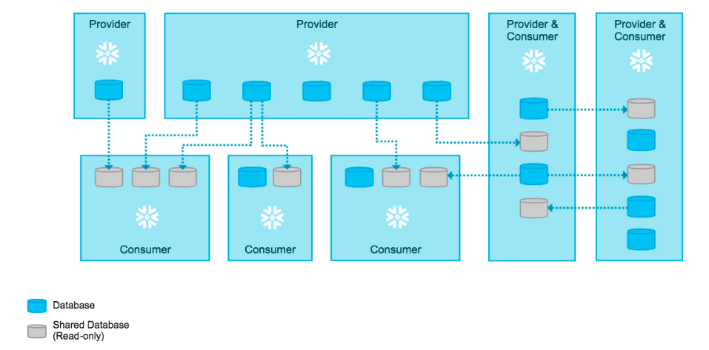
Data Sharing Architecture
Provider Can Share Data With Multiple Consumer both with Internal & External Consumer

Slide 18
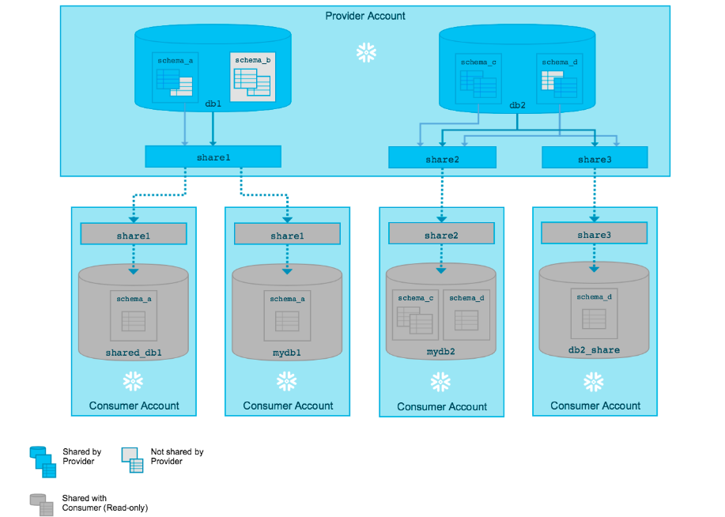
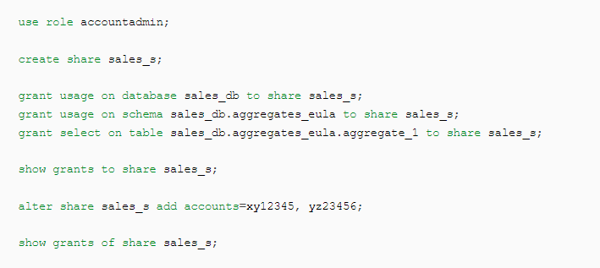
Snowflake - Share
Shares are named Snowflake objects that encapsulate all of the information required to share a database. Each share consists of:
The privileges that grant access to the database(s) and the schema containing the objects to share.
The privileges that grant access to the specific objects in the database.
The consumer accounts with which the database and its objects are shared.
Shares are secure, configurable, and controlled 100% by the provider account:
New objects added to a share become immediately available to all consumers, providing real-time access to shared data.
Access to a share (or any of the objects in a share) can be revoked at any time.

Slide 19
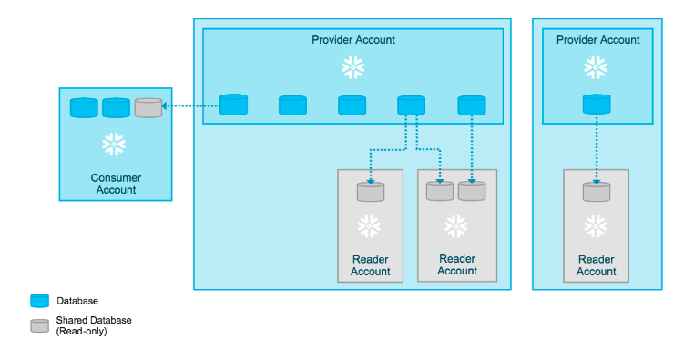

Data Sharing to Non-Snowflake Customer
To facilitate sharing data with non-snowflake consumers, Snowflake supports providers creating reader accounts.
Each reader account belongs to the provider account that created it. Similar to standard consumer accounts, the provider account uses shares to share databases with reader accounts; however, a reader account can only consume data from the provider account that created it:

Slide 20
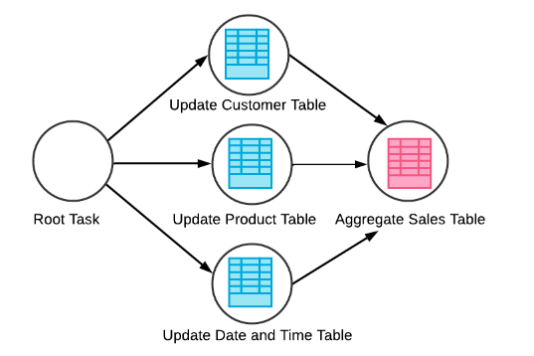
Snowflake Task
Snowflake Task is an Object Which can Execute a SQL Statement, a Store Procedure, or Snowflake Script
Tasks can be combined with table streams for continuous ELT workflows to process recently changed table rows.
We can create Tree of Task(DAG) by creating Task Dependency
Task Can Be Snowflake-managed (i.e. serverless compute model) or User-managed (i.e. virtual warehouse)
DAG Tasks Example

Slide 21

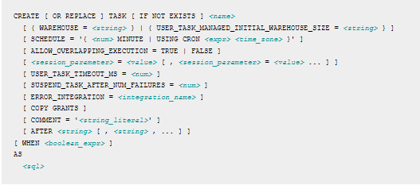
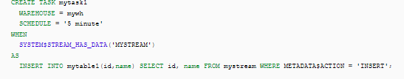



Snowflake Task (Cont’d)
Create Simple Task
Create Conditional Task
Create Task DAG
Create Task to Execute StoreProc
Task DDL - CREATE TASK, ALTER TASK, DROP TASK, DESCRIBE TASK, SHOW TASKS
Create Task Syntax

Slide 22
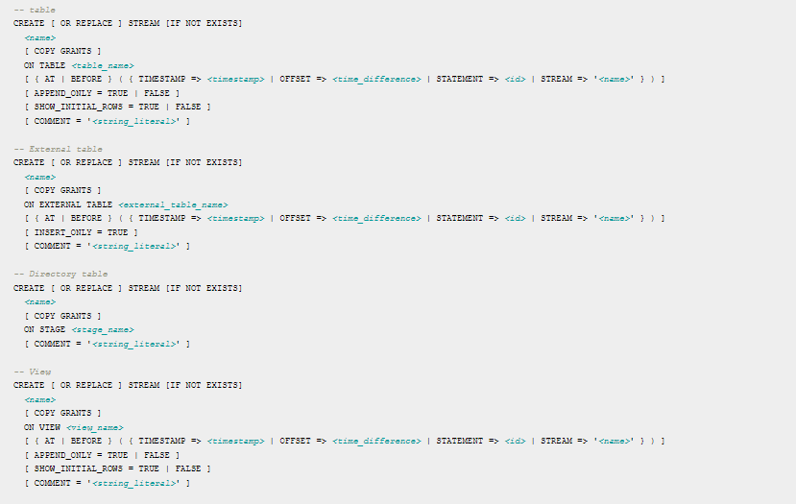
Snowflake Stream
Bookmark Driven DML Change captured mechanism for table
Standard Stream – Row Level Delta for the insert, update, delete operation
Append – Tracks Row Insert Only
Insert Only – Insert Only stream for the external table
Whenever a DML statement consumes the stream contents, the stream position advances to track the next set of DML changes to the table

Slide 23
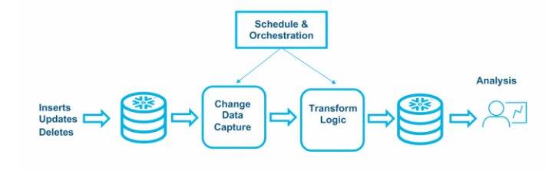
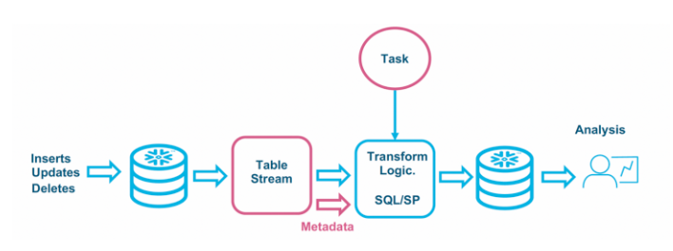
ELT with Stream and Tasks
A General ELT Pattern
ELT With Snowflake

Slide 24
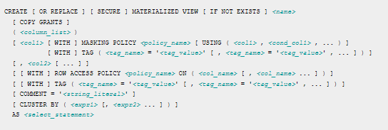
Snowflake Materialized Views
Create a materialized view when all of the following are true:
The query results from the view don’t change often. This almost always means that the underlying/base table for the view doesn’t change often, or at least that the subset of base table rows used in the materialized view don’t change often.
The results of the view are used often (typically significantly more often than the query results change).
The query consumes a lot of resources. Typically, this means that the query consumes a lot of processing time or credits, but it could also mean that the query consumes a lot of storage space for intermediate results.
Create a regular view when any of the following are true:
The results of the view change often.
The results are not used often (relative to the rate at which the results change).
The query is not resource intensive so it is not costly to re-run it.
Create Materialized View Syntax

Slide 25

Snowflake – Data Masking
Dynamic Data Masking is a Column-level Security feature that uses masking policies to selectively mask plain-text data in table and view columns at query time.
In Snowflake, masking policies are schema-level objects, which means a database and schema must exist in Snowflake before a masking policy can be applied to a column. Currently, Snowflake supports using Dynamic Data Masking on tables and views.
At query runtime, the masking policy is applied to the column at every location where the column appears. Depending on the masking policy conditions, the SQL execution context, and role hierarchy, Snowflake query operators may see the plain-text value, a partially masked value, or a fully masked value.
How to Create masking Policy

